Slide 1
WELCOME TO
DATA SCIENCE
Doug Friedman

Slide 2
TODAY’S LEARNING OBJECTIVES
WELCOME TO DATA SCIENCE
Describe the roles and components of a successful learning environment
Define data science and the data science workflow
Apply the data science workflow to meet your classmates
Setup your development environment and review python basics

Slide 3
COURSE
PRE-WORK

Slide 4
PRE-WORK REVIEW
Define basic data types used in object-oriented programming
Recall the Python syntax for lists, dictionaries, and functions
Create files and navigate directories using the command line interface

Slide 5
INTRODUCTION
WHAT IS DATA SCIENCE?

Slide 6
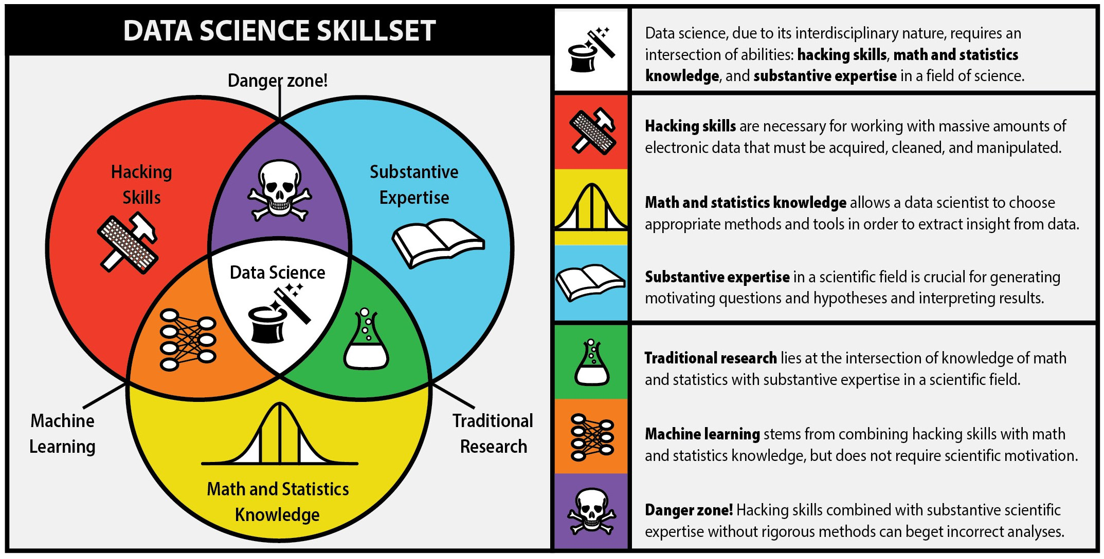
WHAT IS DATA SCIENCE?
Notes:
Image Source: The first rule of data science http://berkeleysciencereview.com/article/first-rule-data-science/

Slide 7
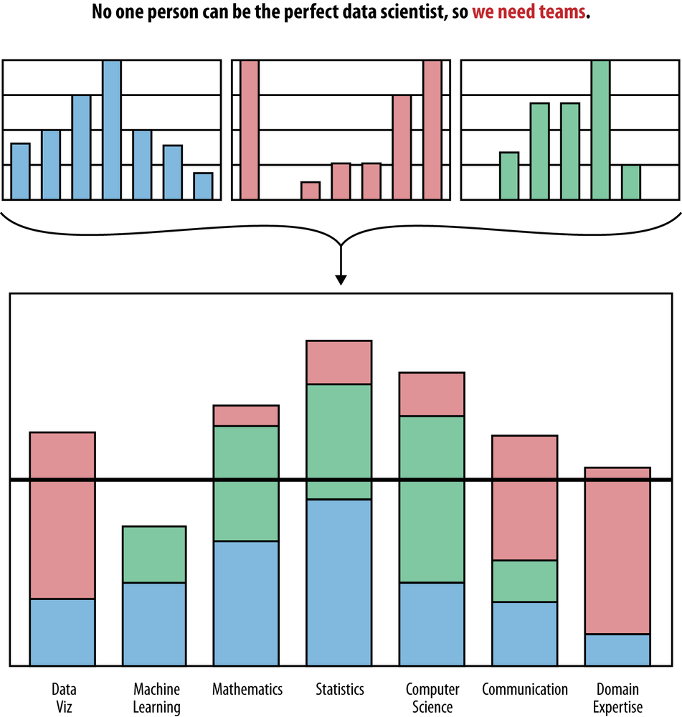
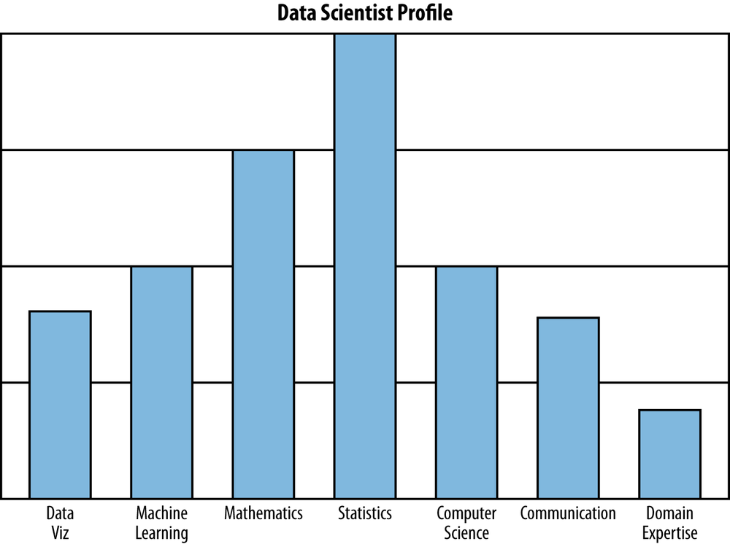
WHAT IS DATA SCIENCE?
Notes:
Image Source: Doing Data Science https://www.safaribooksonline.com/library/view/doing-data-science/9781449363871/ch01.html

Slide 8

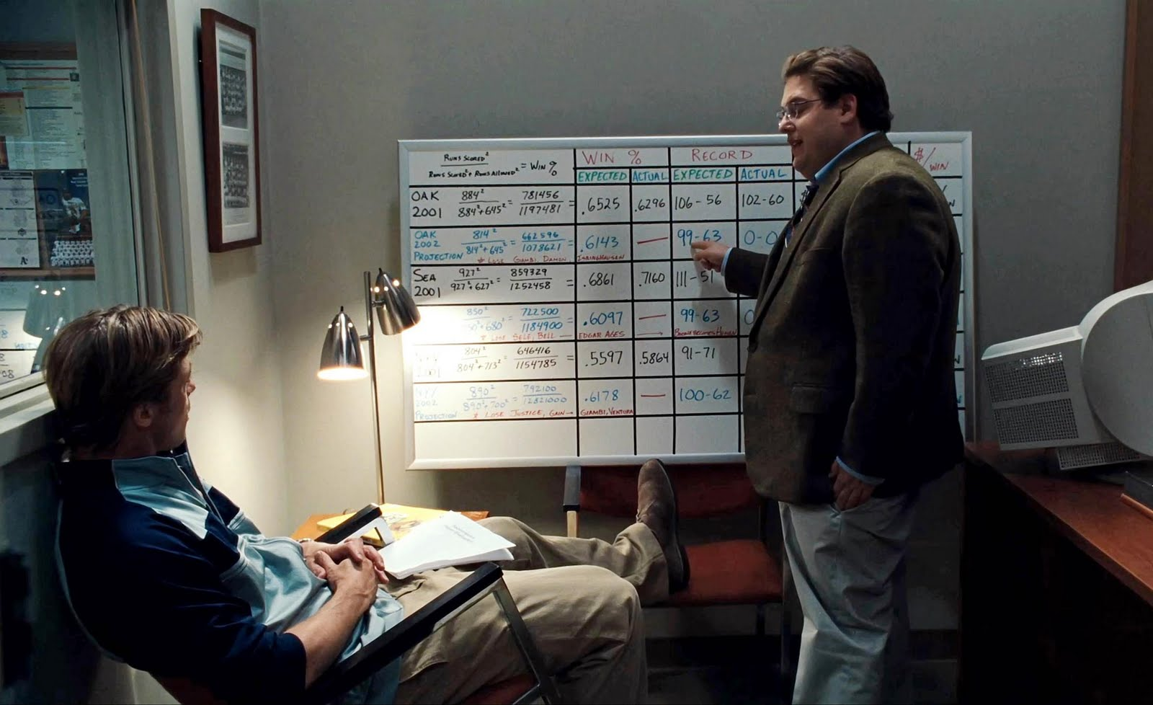
WHAT IS DATA SCIENCE?

Slide 9





WHO USES DATA SCIENCE?

Slide 10
YOUR TURN
Can you think of other organizations that use data science?
How do they use data science to accomplish their goals?

Slide 11
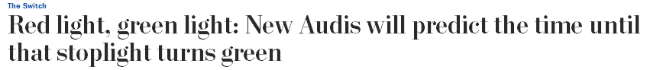

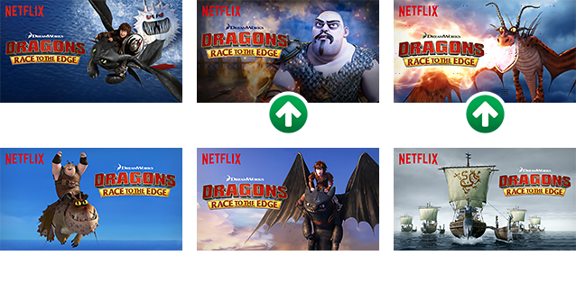
WHO USES DATA SCIENCE?

Slide 12
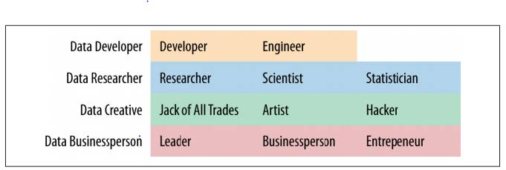
WHAT ARE THE ROLES IN DATA SCIENCE?
Data Science involves a variety of roles, not just one.

Slide 13
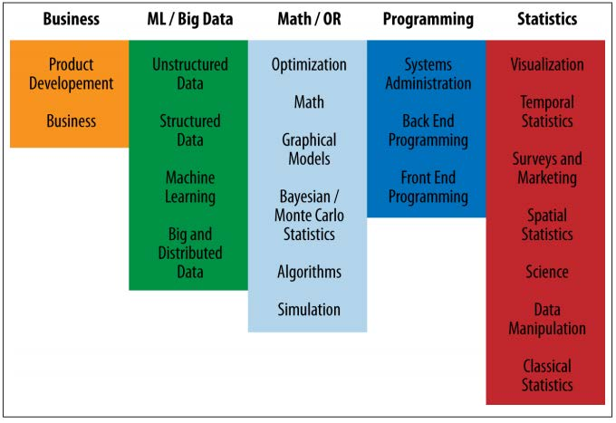
WHAT ARE THE ROLES IN DATA SCIENCE?
Data Science involves a variety of skill sets, not just one.

Slide 14
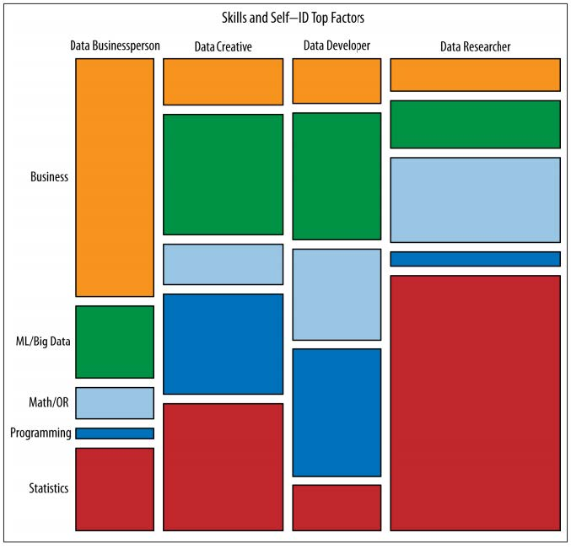
WHAT ARE THE ROLES IN DATA SCIENCE?
These roles prioritize different skill sets.
However, all roles involve some part of each skillset.
Where are your strengths and weaknesses?

Slide 15
QUIZ
DATA SCIENCE BASELINE

Slide 16

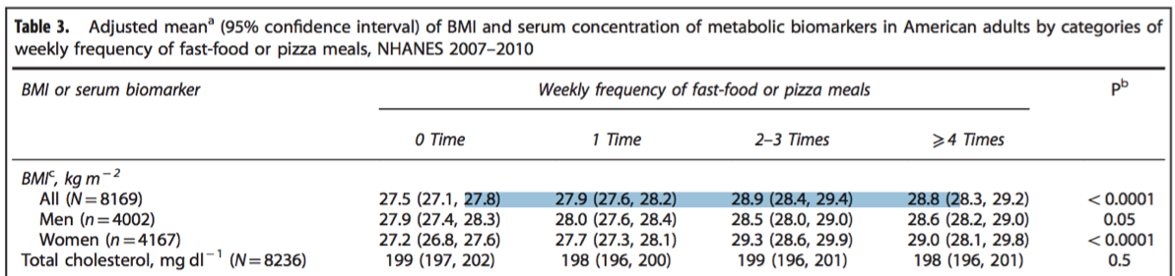
ACTIVITY: DATA SCIENCE BASELINE QUIZ
DIRECTIONS (10 minutes)
Form groups of three.
Answer the following questions.
True or False: Hair color (coded blonde=0, brown=1, red=2, black=3) is a continuous variable.
According to the below, BMI is the _____
Outcome
Predictor
Covariate
Draw a normal distribution
True or False: Linear regression is an unsupervised learning algorithm.
What is a hypothesis test?
EXERCISE

Slide 17
INTRODUCTION
THE DATA SCIENCE WORKFLOW

Slide 18
OVERVIEW OF THE DATA SCIENCE WORKFLOW
Similar to the scientific method, it is a methodology for approaching data science problems and breaking them down into manageable parts.
The goal of the workflow is to help produce reliable and reproducible results to data science problems.
Reliable: Your findings are accurate and defensible.
Reproducible: Other data scientists can follow your process and get the same exact results.

Slide 19
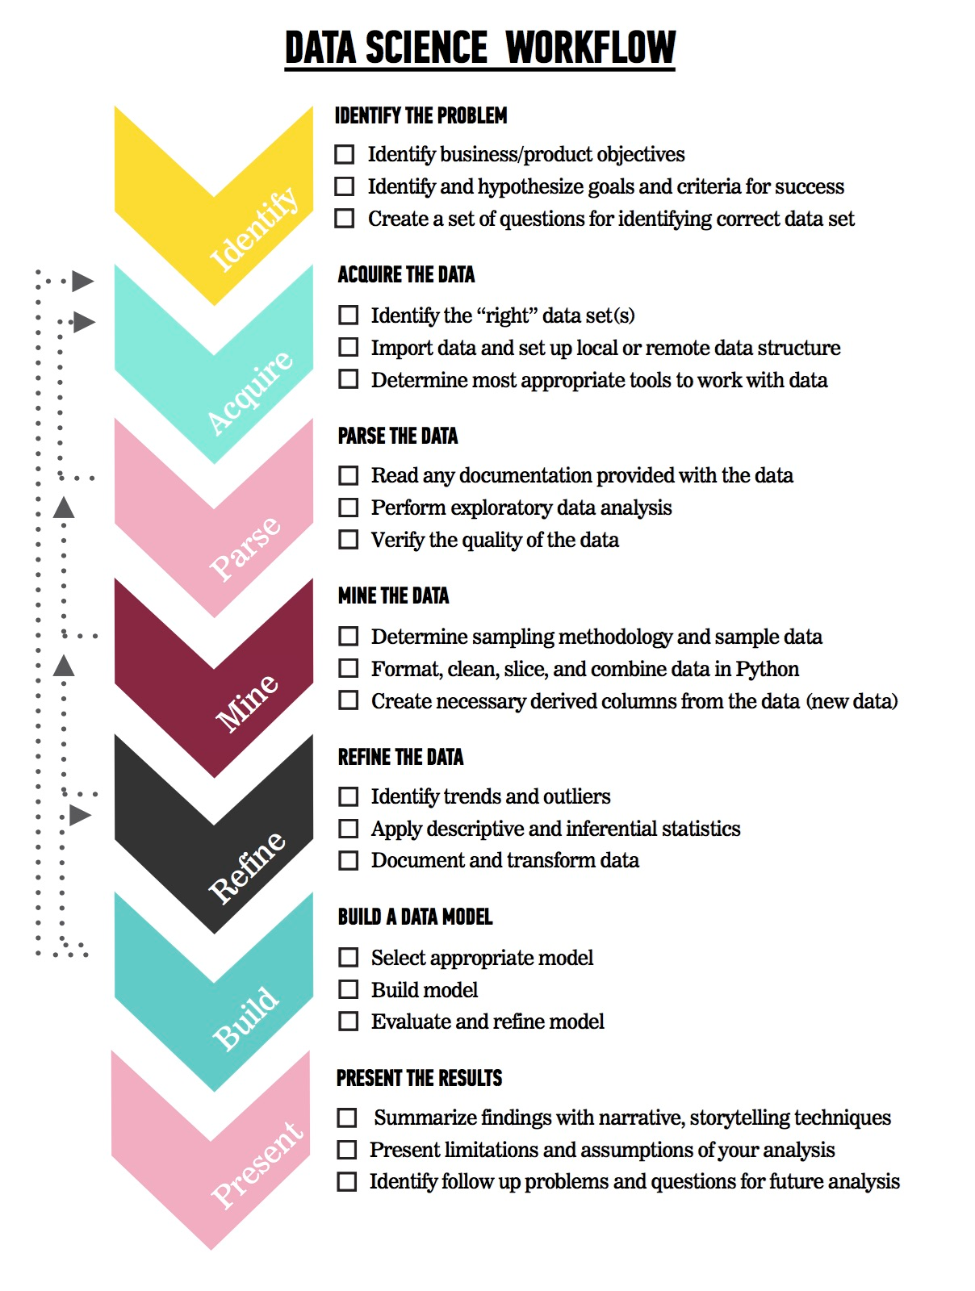
OVERVIEW OF THE DATA SCIENCE WORKFLOW
The steps:
Identify the problem
Acquire the data
Parse the data
Mine the data
Refine the data
Build a data model
Present the results

Slide 20
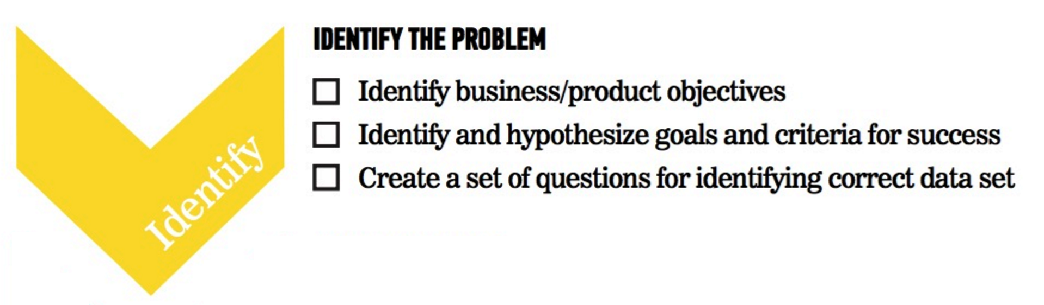
OVERVIEW OF THE DATA SCIENCE WORKFLOW
What is the scope of my problem?

Slide 21
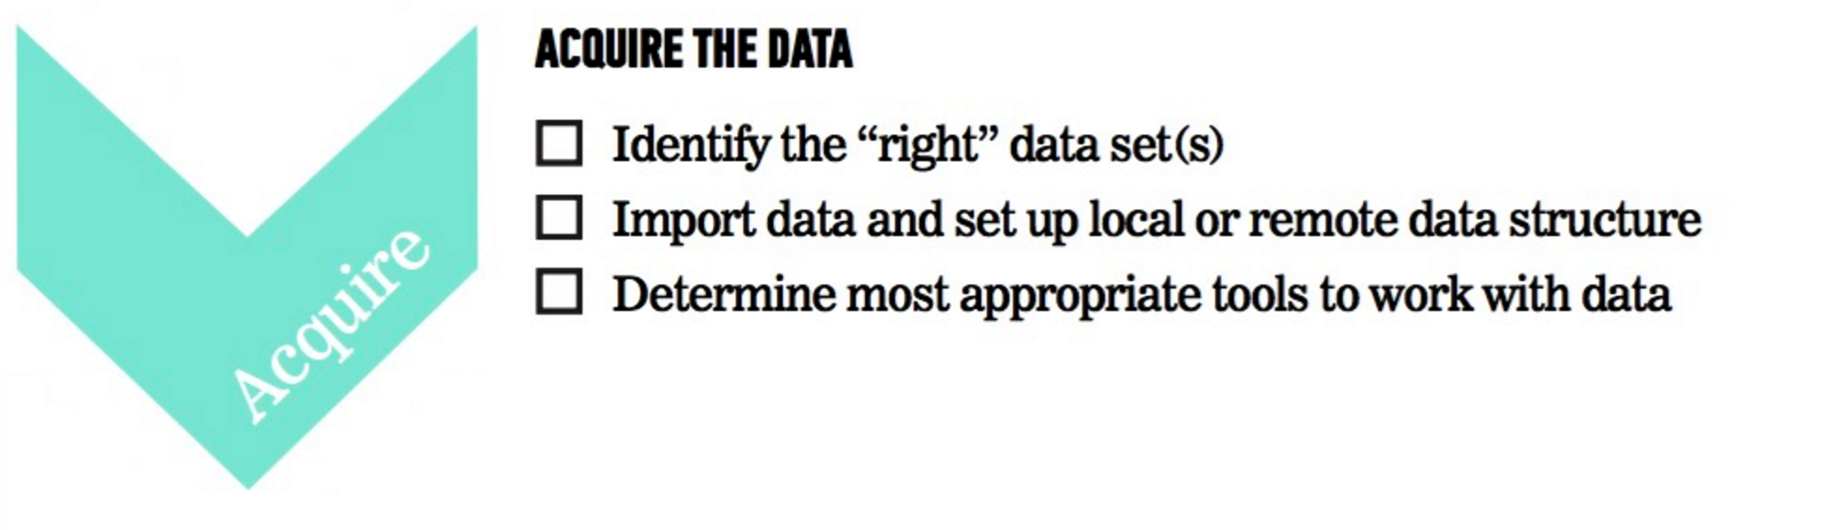
OVERVIEW OF THE DATA SCIENCE WORKFLOW
What tools do I need to solve my problem?

Slide 22
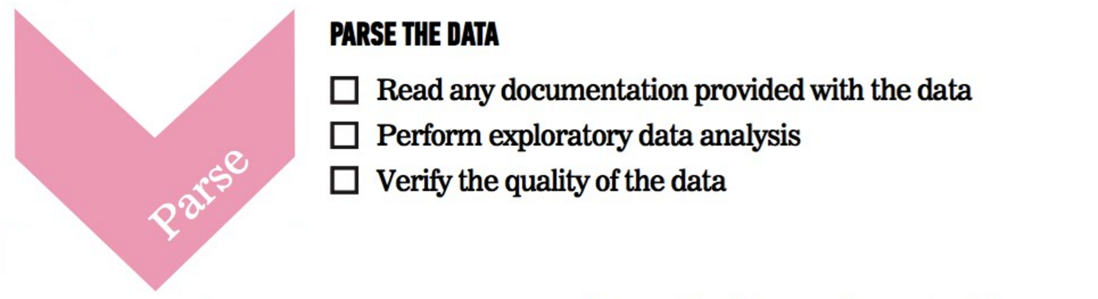
OVERVIEW OF THE DATA SCIENCE WORKFLOW
What information is in this data?

Slide 23
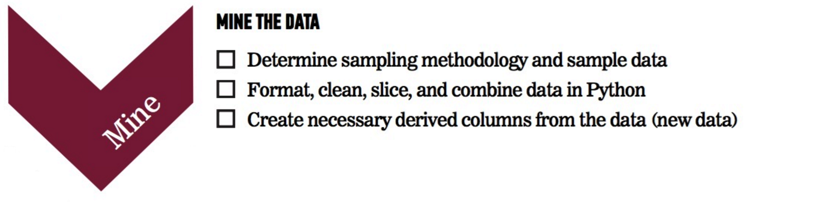
OVERVIEW OF THE DATA SCIENCE WORKFLOW
How can I prepare this data for analysis?

Slide 24
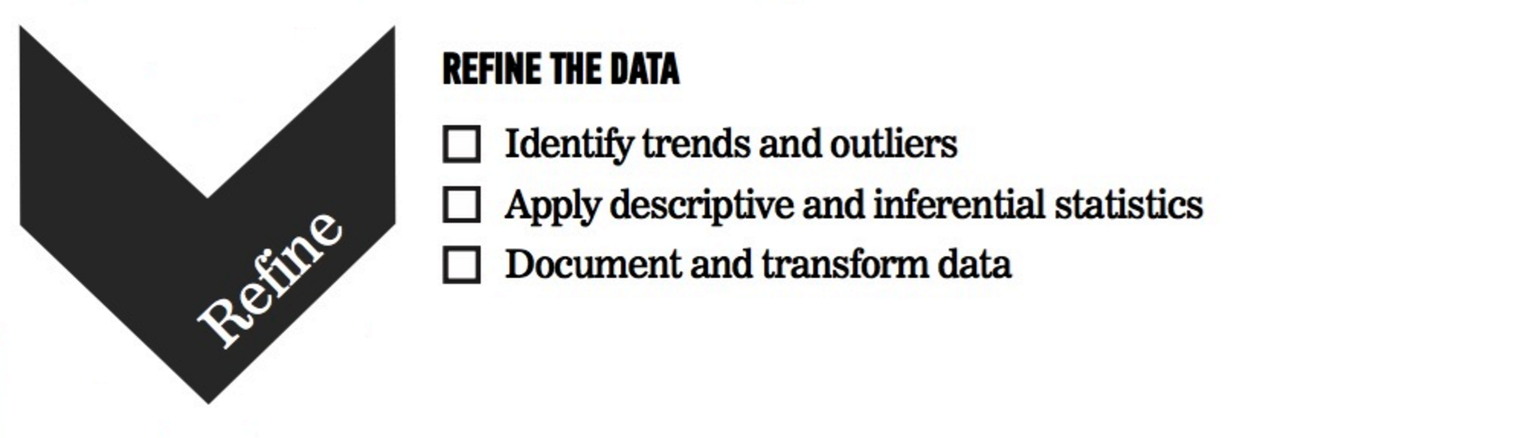
OVERVIEW OF THE DATA SCIENCE WORKFLOW
What patterns are in this data?

Slide 25

OVERVIEW OF THE DATA SCIENCE WORKFLOW
How can I model this data to solve my problem?

Slide 26
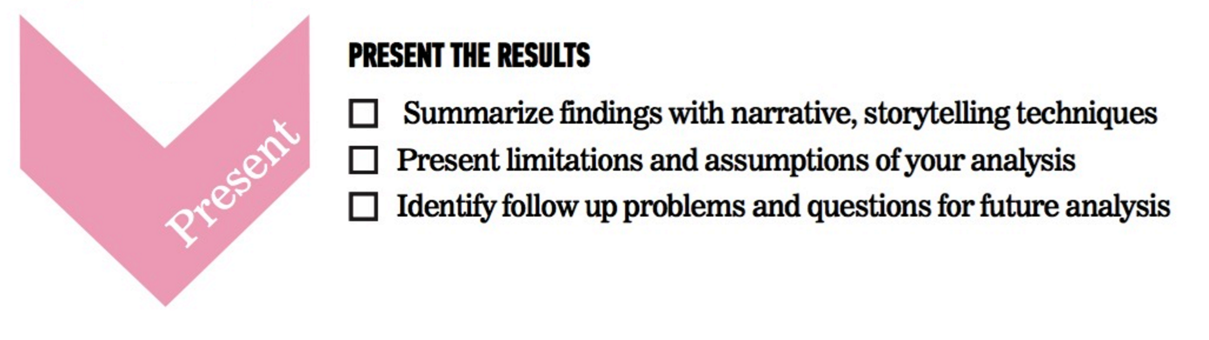
OVERVIEW OF THE DATA SCIENCE WORKFLOW
How do I communicate my solution?

Slide 27
YOUR TURN
Do you think the data science workflow could fit into your current role? Why or why not?
What do you think are the most challenging parts of the data science workflow?

Slide 28

FUTURAMA EXAMPLE
Problem Statement: “Using Planet Express customer data from January 3001-3005, determine how likely previous customers are to request a repeat delivery using demographic information (profession, company size, location) and previous delivery data (days since last delivery, number of total deliveries).”
We can use the Data Science workflow to work through this problem.

Slide 29
FUTURAMA EXAMPLE: IDENTIFY THE PROBLEM
Identify the business/product objectives.
Identify and hypothesize goals and criteria for success.
Create a set of questions to help you identify the correct data set.

Slide 30
FUTURAMA EXAMPLE: ACQUIRE THE DATA
Ideal data vs. data that is available
Learn about limitations of the data.
What data is available for this example?
What kind of questions might we want to ask about the data?

Slide 31
FUTURAMA EXAMPLE: ACQUIRE THE DATA
Questions to ask about the data
Is there enough data?
Does it appropriately align with the question/problem statement?
Can the dataset be trusted? How was it collected?
Is this dataset aggregated? Can we use the aggregation or do we need to get it pre-aggregated?

Slide 32
FUTURAMA EXAMPLE: PARSE THE DATA
Secondary data = we didn’t directly collect it ourselves
Example data dictionary
Variable | Description | Type of Variable
Profession | Title of the account owner | Categorical
Company Size | 1- small, 2- medium, 3- large | Categorical
Location | Planet of the company | Categorical
Days Since Last Delivery | Integer | Continuous
Number of Deliveries | Integer | Continuous

Slide 33
FUTURAMA EXAMPLE: PARSE THE DATA
Questions to ask while parsing
Is there documentation for the data? Is there a data dictionary?
What kind of filtering, sorting, or simple visualizations can help understand the data?
What information is contained in the data?
What data types are the variables?
Are there outliers? Are there trends?

Slide 34
FUTURAMA EXAMPLE: MINE THE DATA
Think about sampling
Get to know the data
Explore outliers
Address missing values
Derive new variables (i.e. columns)

Slide 35
FUTURAMA EXAMPLE: MINE THE DATA
Common steps while mining the data
Sample the data with appropriate methodology
Explore outliers and null values
Format and clean the data
Determine how to address missing values
Format and combine data; aggregate and derive new columns

Slide 36
FUTURAMA EXAMPLE: REFINE THE DATA
Use statistics and visualization to identify trends
Example of basic statistics
Variable | Mean (STD) or Frequency (%)
Number of Deliveries | 50.0 (10)
Earth | 50 (10%)
Amphibios 9 | 100 (20%)
Bogad | 100 (20%)
Colgate 8 | 100 (20%)
Other | 150 (30%)

Slide 37
FUTURAMA EXAMPLE: REFINE THE DATA
Descriptive stats help refine by
Identifying trends and outliers
Deciding how to deal with outliers
Applying descriptive and inferential statistics
Determining visualization techniques for different data types
Transforming data

Slide 38
FUTURAMA EXAMPLE: CREATE A DATA MODEL
Select a model based upon the outcome
Example model statement: “We completed a logistic regression using Statsmodels v. XX. We calculated the probability of a customer placing another order with Planet Express.”
Steps for model building

Slide 39
FUTURAMA EXAMPLE: CREATE A DATA MODEL
The steps for model building are
Select the appropriate model
Build the model
Evaluate and refine the model
Predict outcomes and action items

Slide 40
FUTURAMA EXAMPLE: PRESENT THE RESULTS
You have to effectively communicate your results for them to matter!
Ranges from a simple email to a complex web graphic.
Make sure to consider your audience.
A presentation for fellow data scientists will be drastically different from a presentation for an executive.

Slide 41
FUTURAMA EXAMPLE: PRESENT THE RESULTS
Key factors of a good presentation include
Summarize findings with narrative and storytelling techniques
Refine your visualizations for broader comprehension
Present both limitations and assumptions
Determine the integrity of your analyses
Consider the degree of disclosure for various stakeholders
Test and evaluate the effectiveness of your presentation beforehand

Slide 42
FUTURAMA EXAMPLE: PRESENT THE RESULTS
Example presentations and infographics
512 Paths to the White House
Who Old Are You?
2015 NFL Predictions

Slide 43
GUIDED PRACTICE
DATA SCIENCE WORK FLOW

Slide 44
ACTIVITY: DATA SCIENCE WORKFLOW
DIRECTIONS (25 minutes)
EXERCISE
Divide into 4 groups, each located at a whiteboard.
IDENTIFY: Each group should develop 1 research question they would like to know about their classmates. Create a hypothesis to your question. Don’t share your question yet! (5 minutes)
ACQUIRE: Rotate from group to group to collect data for your hypothesis. Have other students write or tally their answers on the whiteboard. (10 minutes)
PRESENT: Communicate the results of your analysis to the class. (10 minutes)
Create a narrative to summarize your findings.
Provide a basic visualization for easy comprehension.
Choose one student to present for the group.
DELIVERABLE
Presentation of the results

Slide 45
DEMO
ENVIRONMENT SETUP

Slide 46




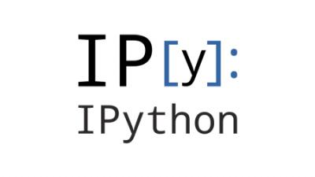

DEV ENVIRONMENT SETUP
A Brief Intro to Our Environment
IPython Notebook Test and Python Review

Slide 47

WHAT IS GIT?
Git is a popular version control system or a method of tracking all changes made to a project (called a repository) by a team of developers.
It provides developers with the tools to work on the project simultaneously without overwriting each other’s changes.

Slide 48
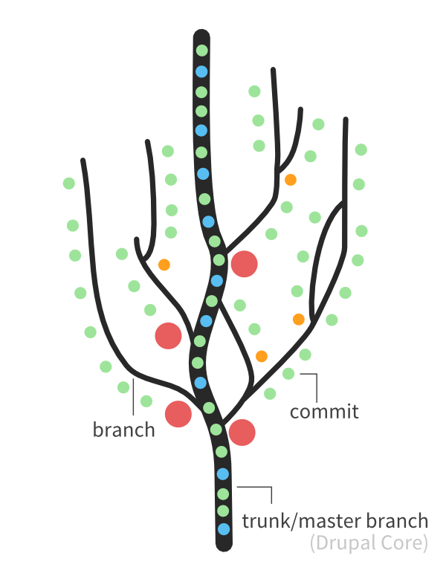
THE LANGUAGE OF GIT
Branch – Different versions of the repository that exist in parallel
Clone – Making an exact copy of the repository
Commit – A contribution by a developer to the repository
Notes:
A Full Glossary Is Available Here - https://help.github.com/articles/github-glossary/

Slide 49
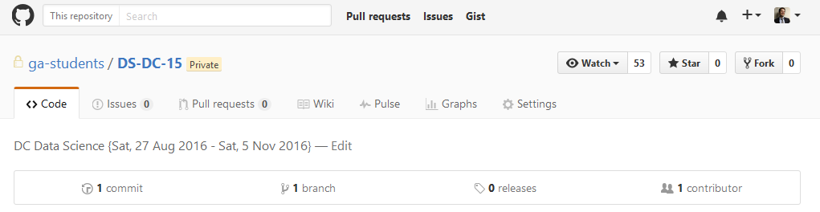
WHAT IS GITHUB?
Github is a website that provides a friendly user interface to Git and adds a number of convenient features (e.g. user profiles, visualizations).

Slide 50
WHAT IS PYTHON?
Python is a popular object-oriented programming language that excels at a number of different tasks (e.g. data science) and has an easy-to-read syntax.
Since Python is open-source, users can contribute additional functionality through packages which are pre-built libraries that users can download and install.
The easiest way to manage the installation and configuration of these packages is with the pip package manager.

Slide 51
WHAT IS ANACONDA?
Anaconda is a distribution of Python that comes pre-installed with many of the packages we will use for data science (e.g. Numpy, Pandas). Its goal is to streamline the process of doing data science work with Python.
It comes with its own package manager called conda that you can use to install additional Python packages.
Don’t worry though as anaconda will work with packages you’ve installed through pip in addition to those installed with conda.

Slide 52
WHAT IS IPYTHON?
IPython is a framework for programming in python that focuses on user interactivity, data visualization, and ease-of-use.
Users create Jupyter notebooks which seamlessly combine notes, code, and visualizations into documents that can easily shared with others.

Slide 53
DEV ENVIRONMENT SETUP
Test your new setup using the lesson 1 starter code available at /lessons/lesson-1/code/starter-code/lesson1-starter-code.ipynb in the Github repo
Ask your classmates and instructor for help if you have problems!

Slide 54
CONCLUSION
REVIEW

Slide 55
CONCLUSION
You should now be able to answer the following questions:
What is Data Science?
What is the Data Science workflow?
How can you have a successful learning experience at GA?

Slide 56
DATA SCIENCE
BEFORE NEXT CLASS

Slide 57
DUE DATE
BEFORE NEXT CLASS
Project: Begin work on Project 1

Slide 58
WELCOME TO DATA SCIENCE
Q & A

Slide 59
WELCOME TO DATA SCIENCE
EXIT TICKET
DON’T FORGET TO FILL OUT YOUR EXIT TICKET

